Slide 1
Applied Genomics Recitation #2: Shell scripts and how to be lazy
Yen-Chung Chen
02/08/2021

Slide 2
Questions?

Slide 3
Quick recap: What you achieved last week
Gain access to NYU HPC
VPN, an HPC account, a working terminal…
Learn to use Linux
Navigating file system: cd, pwd, ls…
Managing with the file system: mkdir, rm, rmdir, cp, mv
Transferring files: scp, wget…
Manipulating text files: cat, head, tail, grep, wc…
Save what’s shown in the terminal as a file (redirection): >
ls –l > “filelist.txt”
Using commands one after another (piping): |
ls –l | grep “*.csv”

Slide 4
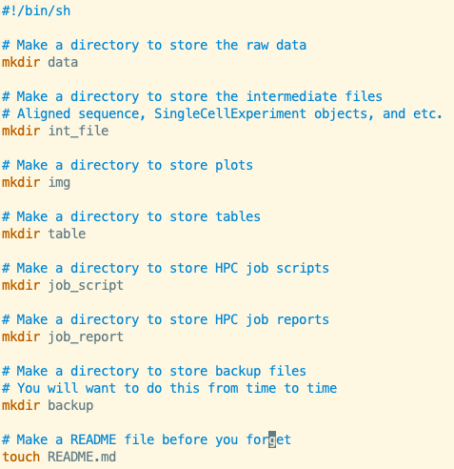
Shell scripts
What is it?
Shell: the terminal interface, the command line…
Script: A file containing a series of commands

Slide 5

Organizing your project folder
What files goes in your HPC?
Example datasets you download
Reference data required for analysis
Gene model (GFF3, GTF…)
Reference genome
Tools that are not available on HPC
Scripts you run for analyses
Output of your analyses
More data files
Plots
Summary tables

Slide 6
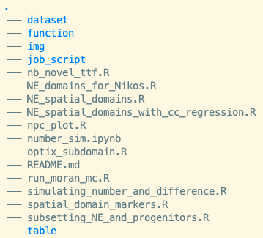
Structure your files
data: The raw data that is not going to change
intermediate files: Result of analyses that will be further used
Scripts for analysis
Images
Tables
Job scripts (What is a job? Stay tuned to the lecture this week!)
Reports of job scripts
Backup

Slide 7
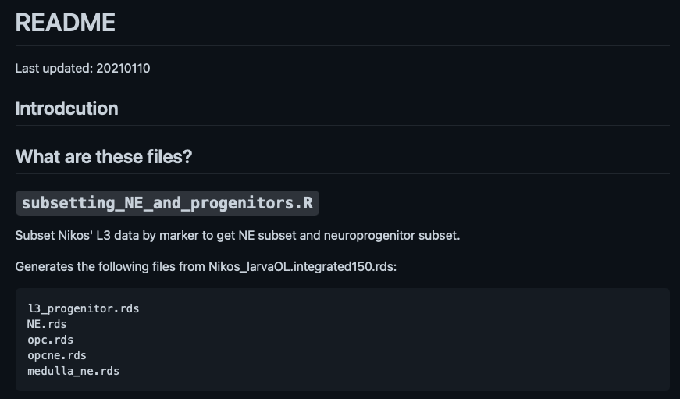

Slide 8
How do I create the whole folder structure at once?
Basically, you are going to create several directories that categorizes your files.
A readme file that describes the use and origin of each file.
In a more sophisticated project, you might want to do it also in folders like intermediate files or tables to make things more tractable.

Slide 9
Shell scripting
When you are running the same commands over and over again.
Shebang (#!)

Slide 10

What’s wrong?
How to grant permission of execution to a file?
chmod +x [file name]

Slide 11
A more complicated example of a shell script
Purpose:
Create a compressed file containing the whole project folder with a timestamp.
How to do this?

Slide 12
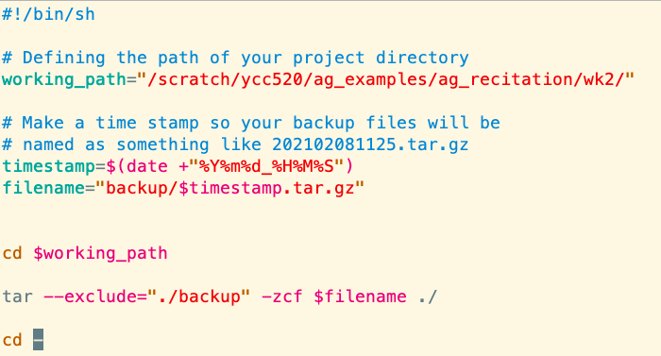
New things in the script
Variables
Must be referred with a $
User input
Command output

Slide 13
An extremely lazy way of doing things
Goal: Backing up the folder every time when you log in onto the HPC.
Caution!
Compression could take a significant amount of computation power.
We should do this with the computation node (elaboration on Wednesday)

Slide 14

Passing information from the command line to your shell script
Question:
Can I do something like:
./backup.sh /scratch/ycc520/wk3
so I can reuse backup.sh?

Slide 15
Questions?

